Slide 1
Data Structure & Algorithms
Session 02
Stack & Queue

Slide 2
Objectives
Introduction to Stack
Application of Stack
Stack representation
Stack Basic operations
Introduction to Queue
Application of Queue
Queue representation
Queue Basic operations

Slide 3
What is a stack
A stack is a Abstract Data Type (ADT), commonly used in most programming languages.
Storing elements with input and output processing according to the LIFO (last In First Out) principle.
Accordingly, elements can be added to the stack at any time when there is enough memory, but only the last added element will be removed first.

Slide 4
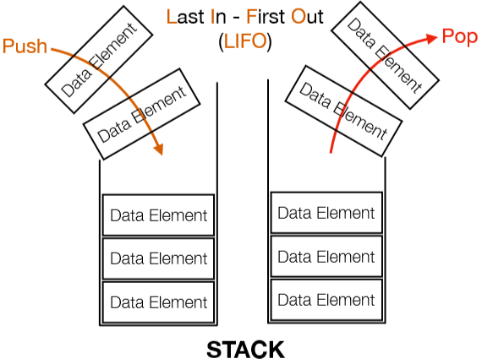
What is a stack
In stack terminology, insertion operation is called PUSH and removal operation is call POP and can be performed only at one end that is called top.
Stacks can either be a fixed size one or it may have a sense of dynamic resizing.
It can be implemented by means of array, structure, pointer and linked list.

Slide 5
Basic operations on a Stack
There are various operations which can be performed on a stack.
The following two primary operations:
Push : Adding an element onto the stack
Pop : Removing an element from the stack
To use a stack efficiently, the following operations is added to stacks:
Peek/Top : gets the top data element of the stack without removing it.
isEmpty : check if stack is empty
isFull : check if stack is full.

Slide 6
Applications of Stack
The simplest application of a stack is to reverse a word. You push a given word to stack - letter by letter - and then pop letters from the stack.
There are other uses also like:
Recursion
Parsing
Expression evaluations and conversions(Infix to Postfix, Postfix to Prefix etc)

Slide 7
Stack representation
In Java,
Stack using Array
public class stack{
public int a[];
public int maxsize;
public int top;
//implements basic operations here.
}
Stack using Linked list
public class node{
public int data;
public node next;
}
public class stack{
public node head;
//implements basic operations here.
}

Slide 8
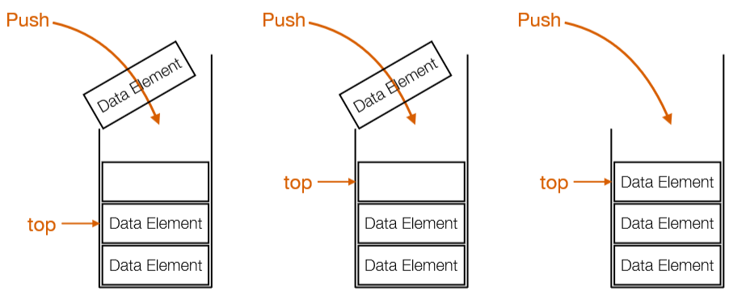
Push operation
Push operation involves a series of steps:
Step 1: checks if the stack is full.
Step 2: if the stack is full, display an error and exit.
Step 3: if the stack is not full, increments top to point next empty space .
Step 4: adds data to the stack location, where top is pointing.
Step 5: returns success .

Slide 9
Push operation
Array implementation
public boolean Push(int x)
{
if(top == maxsize-1)
{
System.out.println("stack is full!");
return false;
}
top = top+1;
a[top]=x;
System.out.println("data pushed into stack!");
return true;
}

Slide 10
Pop operation
Pop is a operation used to remove an element from the stack.
However, in an array implementation of pop operation, the data element is not actually removed, instead top is decremented to a lower position in the stack to point to the next value.
But, in linked list implementation of pop operation, the data element is actually removed and deallocates memory space.

Slide 11
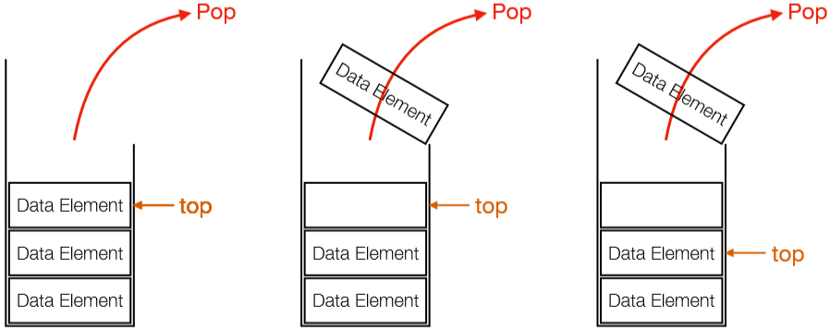
Pop operation
Push operation involves a series of steps:
Step 1: checks if the stack is empty.
Step 2: if the stack is empty, display an error and exit.
Step 3: if the stack is not empty, accesses the data element at which top is pointing.
Step 4: decreases the value of top by 1.
Step 5: returns the data element.

Slide 12
Pop operation
Array implementation
public boolean Pop()
{
if(top == -1)
{
System.out.println("stack is empty!");
return false;
}
int x = a[top];
top = top-1;
System.out.println("data popped from the stack: "+x);
return true;
}

Slide 13
What is a Queue
A queue is a Abstract Data Type (ADT), somewhat similar to Stacks.
Unlike stacks, a queue is open at both its ends. One end is always used to insert data (enqueue) and the other is used to remove data (dequeue).
Storing elements with input and output processing according to the FIFO (First In First Out) principle.

Slide 14
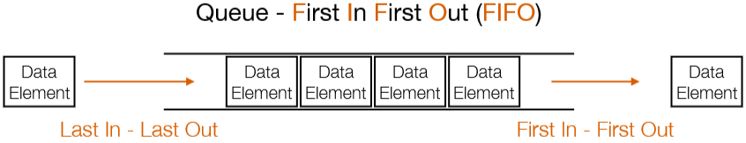
What is a Queue
As we now understand that in queue, we access both ends for different reasons.
The following diagram given, tries to explain queue representation as data structure.
As a stack, a queue can also be implemented using arrays, structures, pointer and linked list.

Slide 15
Applications of Queue
There are various applications of queues:
It is widely used as waiting lists for a single shared resource like printer, disk, CPU.
It is used in asynchronous transfer of data for eg. file IO, sockets,…
In media players, it is used to to add and remove the songs from the play-list.
In operating systems, it used for handling interrupts.
Call Center phone systems uses it to hold people calling them in an order, until a service representative is free.

Slide 16
Queue representation
In Java,
Queue using Array
public class queue{
public int a[];
public int maxsize;
public int front;
public int rear;
//implements basic operations here.
}
Queue using Linked list
public class node{
public int data;
public node next;
}
public class queue{
public node head;
//implements basic operations here.
}

Slide 17
Basic operations on a Queue
A queue is used for the following two primary operations:
enqueue: Adding an element to the queue.
dequeue: Removing an element from the queue.
Few more functions are require to make the above-mentioned queue operation efficient:
Peek/Front: gets the element at the front of the queue without removing it.
isEmpty : check if queue is empty
isFull : check if queue is full.

Slide 18
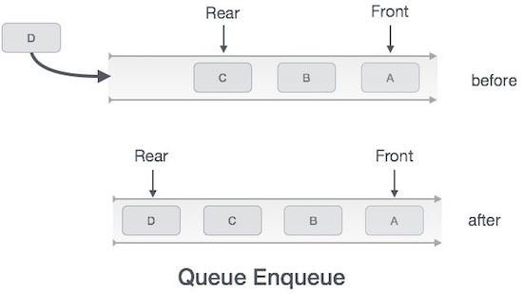
Enqueue operation
The following steps should be taken to enqueue operation
Step 1 − Check if the queue is full.
Step 2 − If the queue is full, produce overflow error and exit.
Step 3 − If the queue is not full, increment rear pointer to point the next empty space.
Step 4 − Add data element to the queue location, where the rear is pointing.
Step 5 − return success.

Slide 19
Enqueue operation
public boolean enqueue (int item)
{
if (rear + 1 == maxsize)
{
System.out.println("queue is overflow");
return false;
}
else
{
if(front == -1 && rear == -1) front = rear = 0;
else rear = rear + 1;
queue[rear]=item;
System.out.println("data inserted to queue");
return true;
}
}

Slide 20
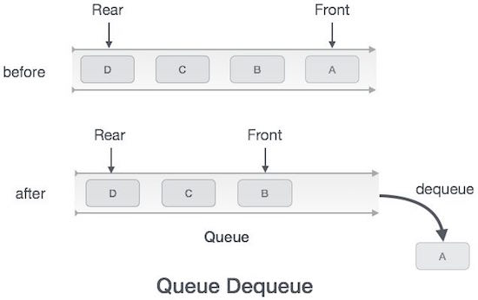
Dequeue operation
The following steps are taken to perform dequeue operation
Step 1 − Check if the queue is empty.
Step 2 − If the queue is empty, produce underflow error and exit.
Step 3 − If the queue is not empty, access the data where front is pointing.
Step 4 − Increment front pointer to point to the next available data element.
Step 5 − Return success.

Slide 21
Enqueue operation
public boolean dequeue ()
{
if (front == -1 || front > rear)
{
System.out.println("queue is underflow");
return false;
}
else
{
int x = queue[front];
if (front == rear) front = rear = -1;
else front = front + 1;
System.out.println("data removed from queue:" +x);
return true;
}
}

Slide 22
Summary
Stack is an ordered list in which, storing elements with input and output processing according to the LIFO (last In First Out) principle.
In stack terminology, insertion operation is called PUSH and removal operation is call POP insertion and can be performed only at one end that is called top.
A queue is a Abstract Data Type (ADT), somewhat similar to Stacks. Queue is referred to be as First In First Out list.
Unlike stacks, a queue is open at both its ends. One end is always used to insert data (enqueue) and the other is used to remove data (dequeue).
Both stack and queue can be implemented using arrays, structures, pointer and linked list.

Slide 23
References
https://www.techiedelight.com/stack-implementation-in-java/
https://java2blog.com/implement-stack-using-array-in-java/
https://www.javatpoint.com/data-structure-stack
https://www.tutorialspoint.com/data_structures_algorithms/dsa_queue.htm
https://www.studytonight.com/data-structures/queue-data-structure
https://www.geeksforgeeks.org/p5-js-enqueue-operation-in-queue/

Slide 24


